Slide 1
Exploring posts about face masks on Twitter
Countries often compared: Denmark, Germany, Sweden and Norway
A comparative text mining analysis of the Danish, Swedish, Norwegian and German twitter posts:
How do people communicate about face masks?
Is the communication influenced by the country’s policy on face masks?
Yet, very different political approaches to face masks
The public discussion is stuck: What about the “cultural stuff”: communication, perceptions and the interplay between politics and the public opinon?

Slide 2
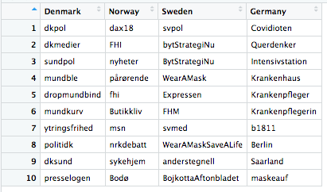
Results so far:
Notes:
After filtering common words such as ”facemask” and ”coronavirus” away, I ended up with these words as the most used hashtags for the different countries
Interesting:
A lot of negative words for denmark: ”mouthdiaper”, ”giveupface masks”, ”muzzle”, ”freedom of speech”
Germany: A lot of tensions are reflected - ”querdenker” word for anti-face mask believers and ”b1811” refers to anti face mask-demonstration whereas covidioten is used for people who don’t follow the rules
Whereas Sweden: ”chancestrategy”, ”wearamask”, ”anderstegnell”

